Slide 1
Evaluating Transportation Mode Choice:
The Effects of
Clipper® BayPass
CE 264: Behavioral Modeling
May 4, 2023
Notes:
Winnie

Slide 2
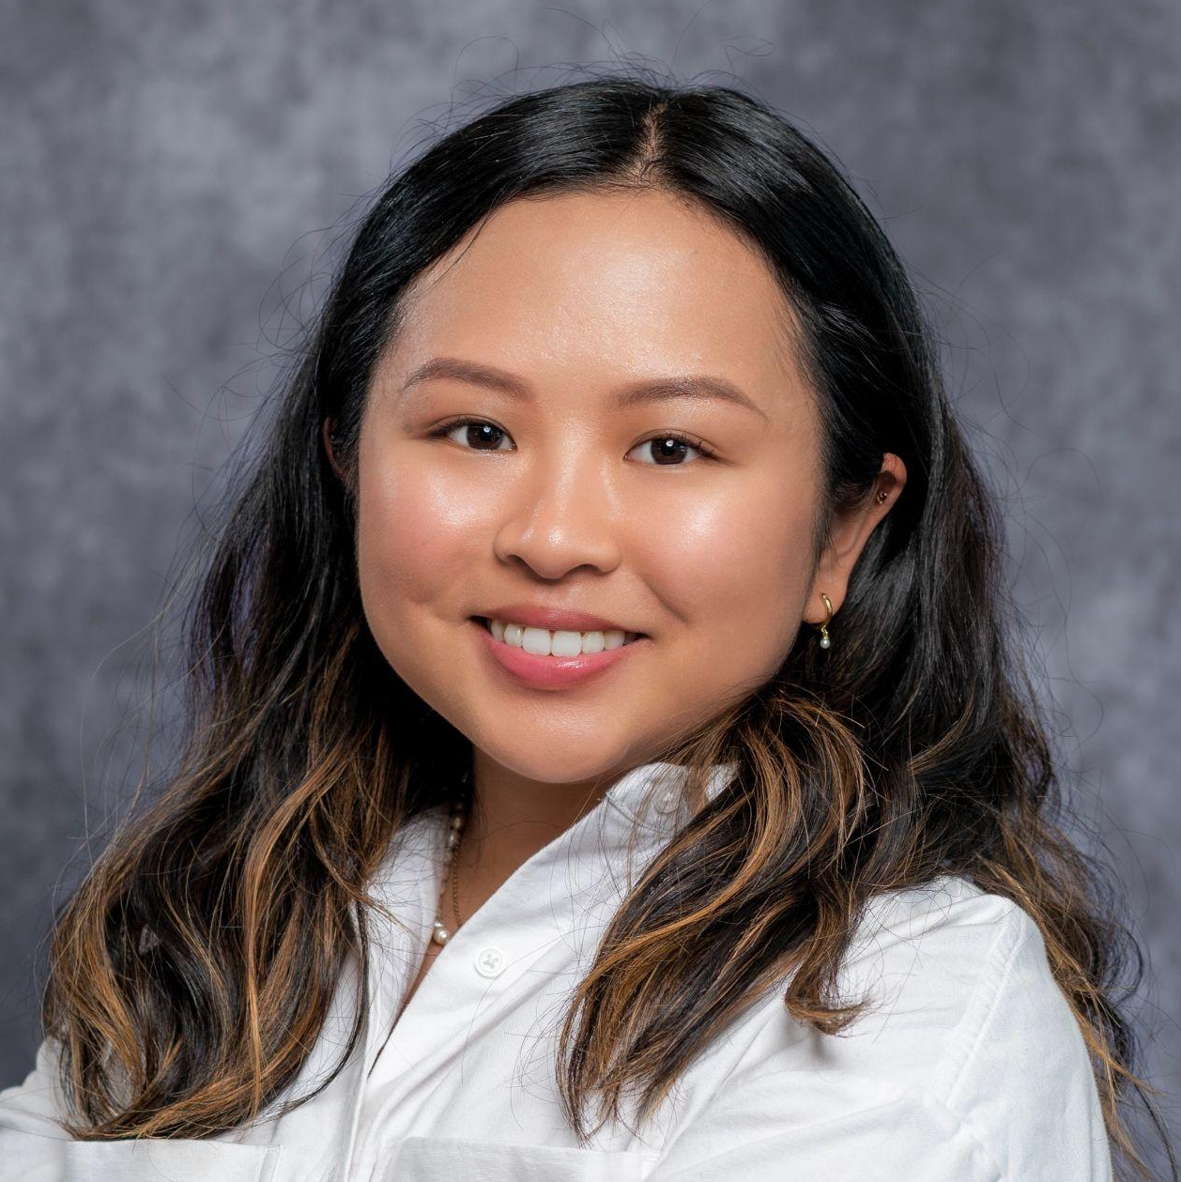

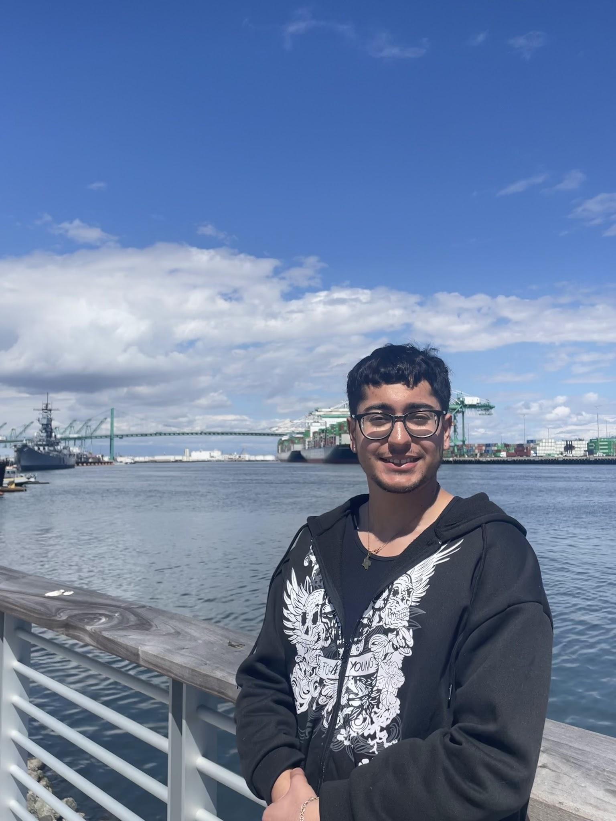

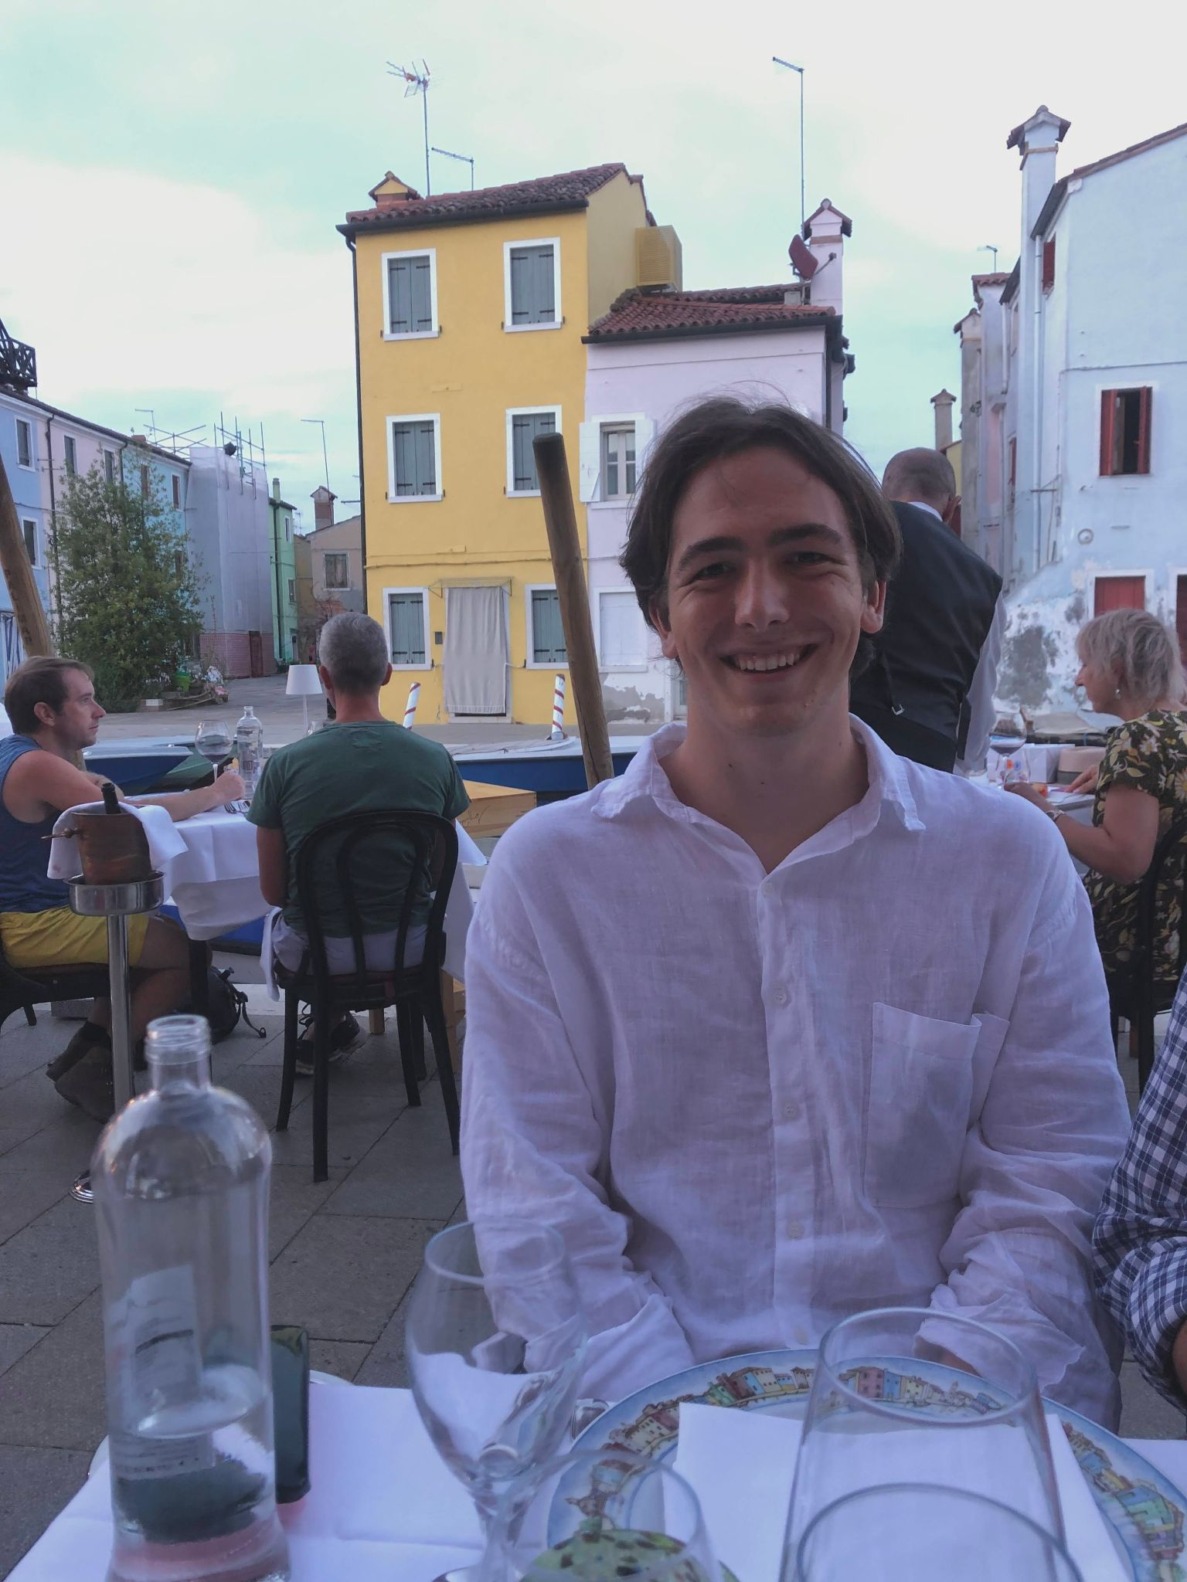

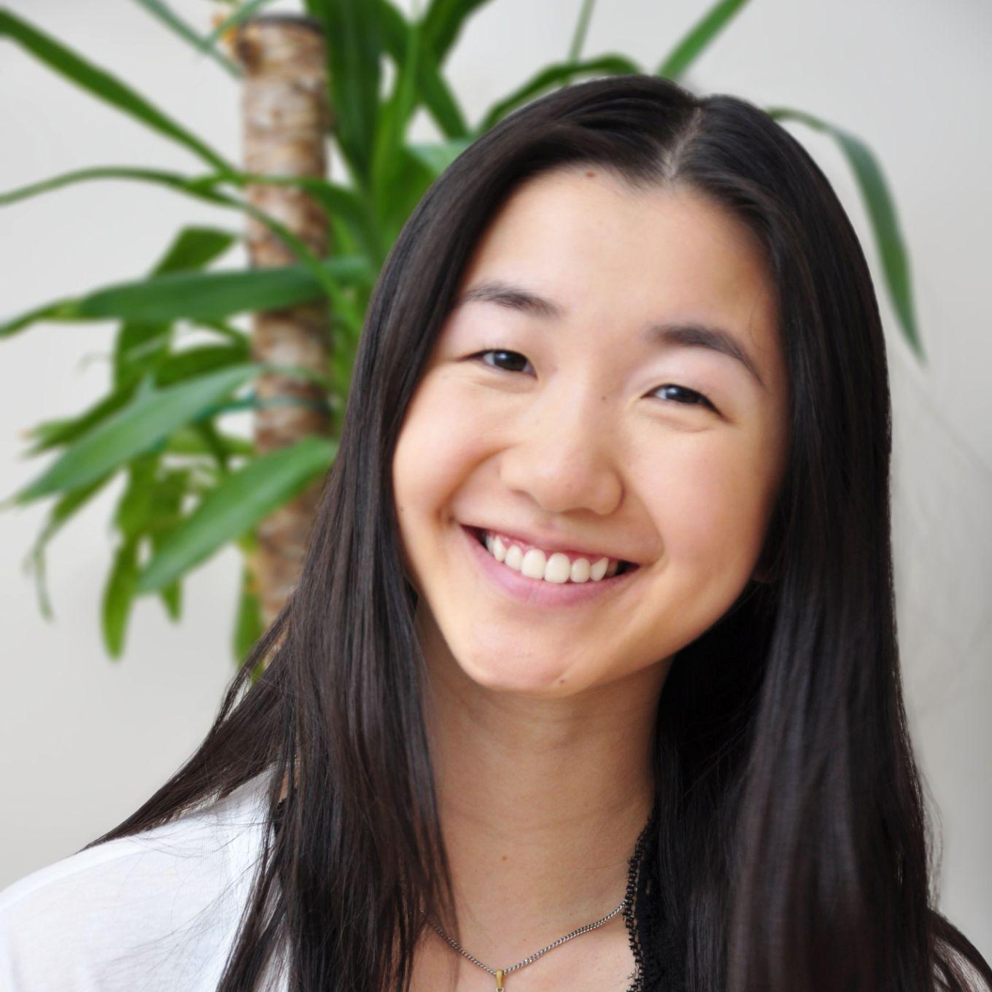
OUR TEAM
Angie Chen
MCP Transportation
Planning
Cam Kees
MS Transportation Engineering
MCP Transportation Planning
Andre Soucy
MCP Transportation
Planning
Priya Pallivathucal
MS Transportation Engineering
Giuseppe Perona
BA Computer Science,
City Planning Minor
Melody Tsao
MS Transportation Engineering
MCP Transportation Planning
Winnie Zhuang
MS Transportation Engineering
MCP Transportation Planning
Notes:
Winnie

Slide 3


INTRODUCTION
What is the Student EasyPass?
Paid for by student fees
Notes:
Winnie

Slide 4
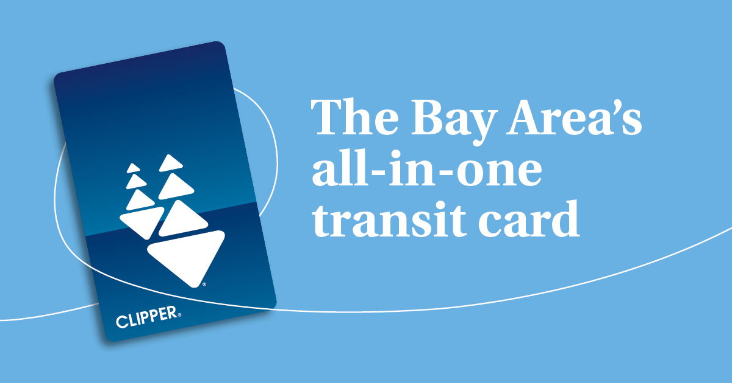
CLIPPER BAYPASS
What is the Clipper® BayPass?
What is the purpose of the pilot program?
Notes:
Winnie to pass onto Andre

Slide 5
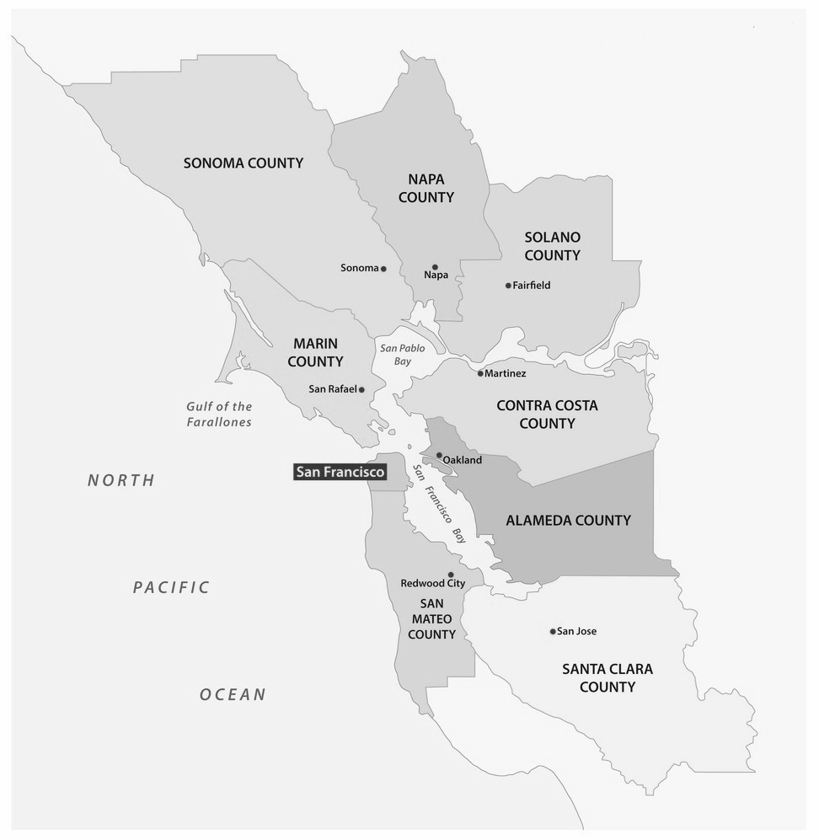
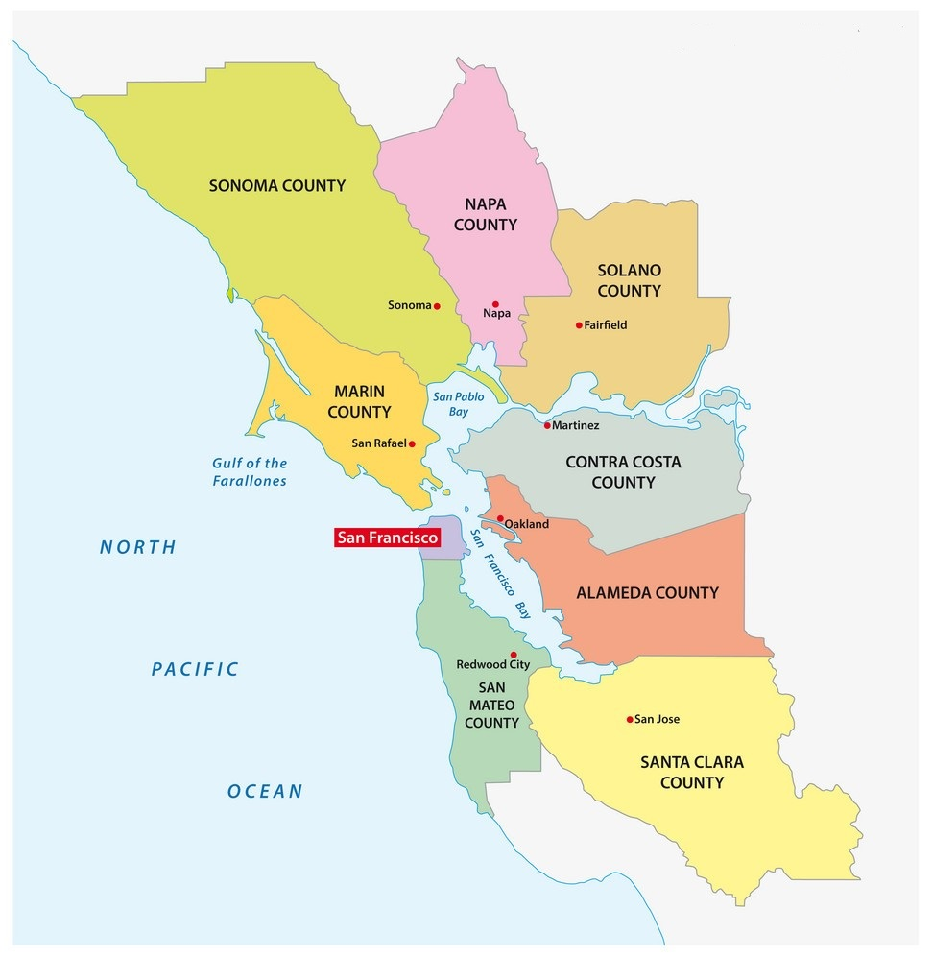
PILOT PROGRAM
Phase 1:
Select colleges
Select MidPen housing communities
Phase 2:
Some major employers
Santa Rosa
Jr. College
UC Berkeley
SF State University
SJ State University
Notes:
Andre
So Baypass has two phases
The first one focuses on select unis/colleges and select MidPen housing communities (affodable/worlforce housing)
Click
The second phase is coming later this summer, and that will focus on some major employers in the bay area
Our project will focus on the UC Berkeley student population

Slide 6
RESEARCH OBJECTIVES & MOTIVATION
Research Questions
What is the relationship between BayPass ownership and transit usage? What is the willingness to pay for BayPass?
How does campus affiliation affect mode choice?
Motivation
Curiosity about how subsidized/free public transit will affect mode choice in the Bay Area and whom it will most affect — which has implications on sustainability, equity, and traffic congestion.
Notes:
Andre
Our team had two main research questions
One focuses on the relationship bt BayPass ownership and transit use, so how does transit use change with the addition of BayPass, as well as how do other mode shares change with transit shares
As part of this we want to investigate the willingness to pay for BayPass across the population
Another focus is how campus affiliation generally affects or correlates with mode choice
We’re investigating these research questions because we are curious about how subsidized/free access to public transit affects mode choice in the bay area, and whom it will affect most - looking at implications for sustainability (what share of modes are sustainable), equity (who bears the benefits/detriments of this policy), and traffic congestion (how many vehicles/people are on roads/transit)

Slide 7
METHODS & RESULTS
Notes:
Andre to pass onto Angie

Slide 8
METHODOLOGY
Stated Preference (SP) survey
128 respondents
Collection methods: classmate participation, posting flyers in UC Berkeley buildings with QR code, social media, word-of-mouth
Multinomial discrete mode choice base model
Linear regression & statistical analysis
Explanatory variables: BayPass ownership, travel time, access time, travel cost, campus affiliation (student vs. non-student)
Forecasting
Weighting (stratified sample) and forecasting mode split with BayPass ownership
Notes:
Angie

Slide 9


Slide 10

SURVEY DESIGN
Questions about personal characteristics
Mode choice scenarios
Travel time, waiting/parking time, and travel cost
7 modes: bike/scooter, walk, drive alone, shared ride, bus, rail
3 scenarios: no BayPass (typical public transit costs)
3 scenarios: with BayPass (travel cost = $0)
Notes:
Angie

Slide 11
SURVEY DESIGN
Customized travel time, waiting/parking time, and cost ranges for each mode to ensure realistic scenarios
 | Walk | Bike/ Scooter | Bus | Rail | Drive | Rideshare
Travel Time (min) | 17-55 | 12-40 | 5-35 | 5-35 | 5-25 | 5-25
Waiting or Parking Time (min) | 0 | 0 | 0-20 | 0-20 | 0-20 | 0-20
Travel Cost ($) | 0 | 0 | 1-6 (0 for BayPass) | 1-8 (0 for BayPass) | 1-10 | 5-20
Notes:
Angie

Slide 12
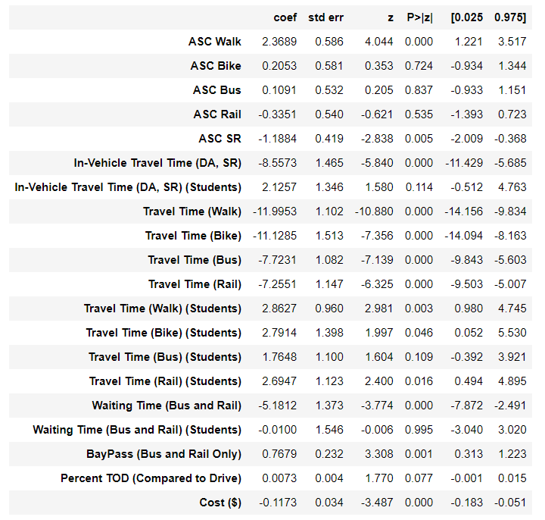
BASE MODEL OUTPUT
PARAMETERS & STATISTICS
PYLOGIT OUTPUT
Notes:
Melody
Using the data collected from the survey, a base model was estimated. In our model, our main parameters were travel time, waiting time, and cost. Travel time was interacted against if a person was a student or not. Additionally, we included a bypass parameter only for the transit alternatives and a percent TOD.
Smaller table will appear as a transition when we play the slide deck! It won’t block the other table.

Slide 13
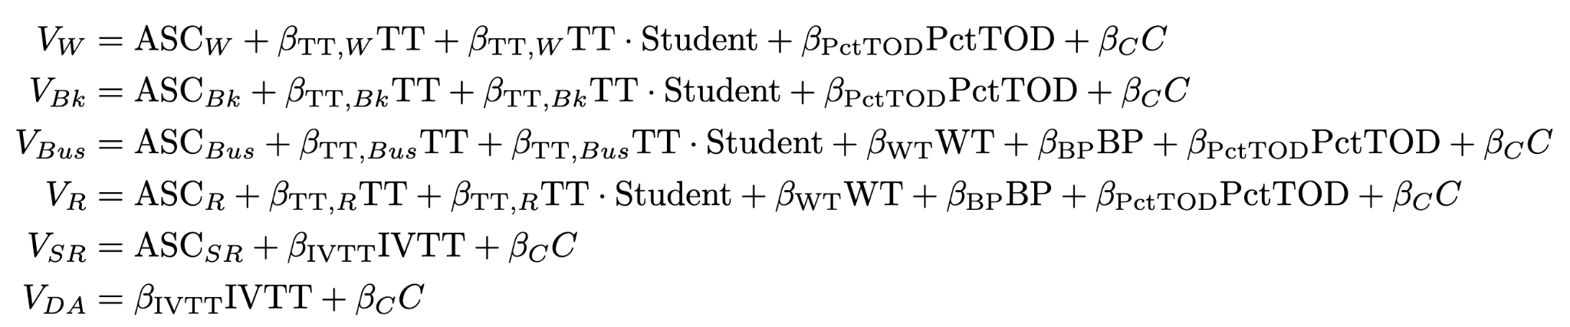
BASE MODEL OUTPUT
PARAMETERS & STATISTICS
UTILITY FORMULAS
Notes:
Melody
This is our utility function

Slide 14
FORECASTING RESULTS
MODE SPLIT
Mode | Weighted Probability | Forecasted Probability with BayPass Ownership
Walk | 36.50% | 31.59%
Bike | 13.76% | 10.89%
Bus | 23.15% | 28.47%
Rail | 18.03% | 22.76%
Drive Alone | 6.33% | 4.69%
Shared Ride | 2.23% | 1.60%
Notes:
Melody
From our base model, a forecast was then conducted. We first conducted a weighted probability based on our base model. Our sample was weighted using campus affiliation and then narrowed down to whether respondent was a student or non-student. We assumed everyone taking the survey was somehow related to Berkeley even if they were not affiliated with UC Berkeley.
For our forecast, we look at how mode share changes when every individual has a BayPass. With BayPass, probability of taking bus or rail increases while all other modes decrease.
he campus commute

Slide 15
ANALYSIS
With BayPass ownership:
23% increase in bus ridership
26% increase in rail ridership
26% decrease in driving alone → could allow for significant GHG reduction
Average passenger vehicle emits about 404 grams of CO₂ per mile
Most UC Berkeley campus affiliates commute 2 miles/day total
Notes:
Melody
Percent change of 23% in bus ridership, 26% in rail ridership and 26% in driving alone. Decrease in driving alone could allow for significant GHG reduction as an average passenger vehicle emits about 404 grams of CO2 per mile and most UC berkeley campus affiliates commute 2 miles/day.

Slide 16
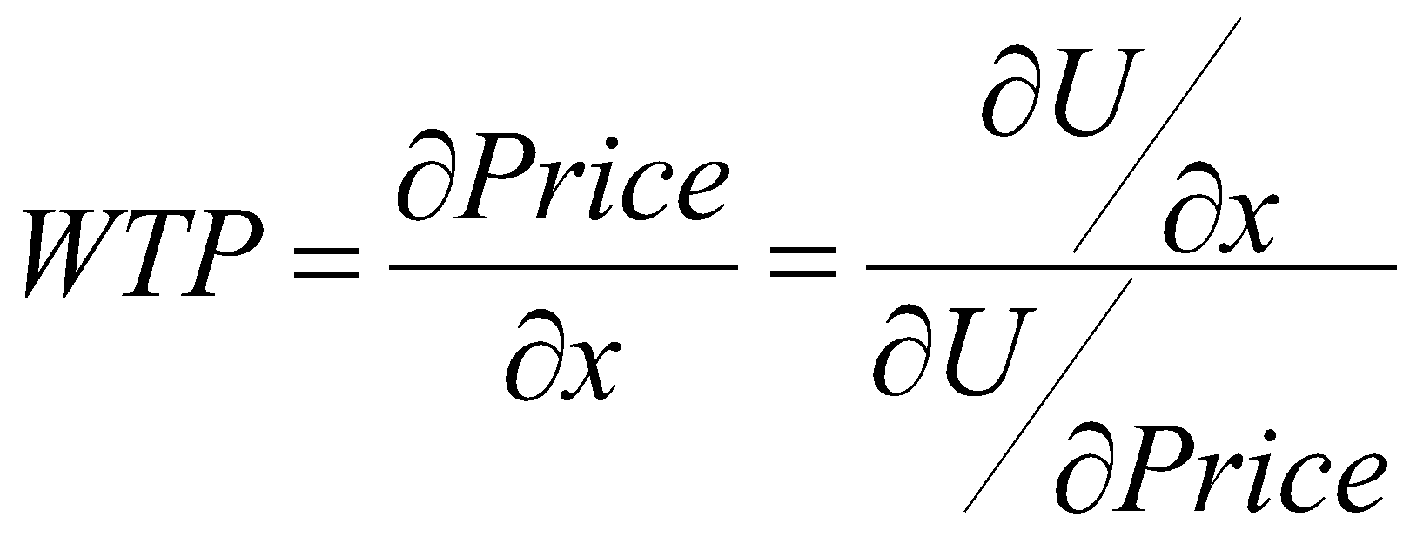
ANALYSIS
Willingness-to-pay (WTP) for BayPass:
WTP = $6.55/Trip
Notes:
Cam
$982.5 Semesterly

Slide 17
ANALYSIS
Willingness-to-pay (WTP) for BayPass
High value indicates strong desire for BayPass and may include other factors such as the “value of free”
High value among student population which may drive policy decisions regarding prioritizing subsidized transit for students
Notes:
Cam
Future implications for Berkeley planning and Transit providers to value BayPass if project is moved forward and replaces the Class Pass

Slide 18
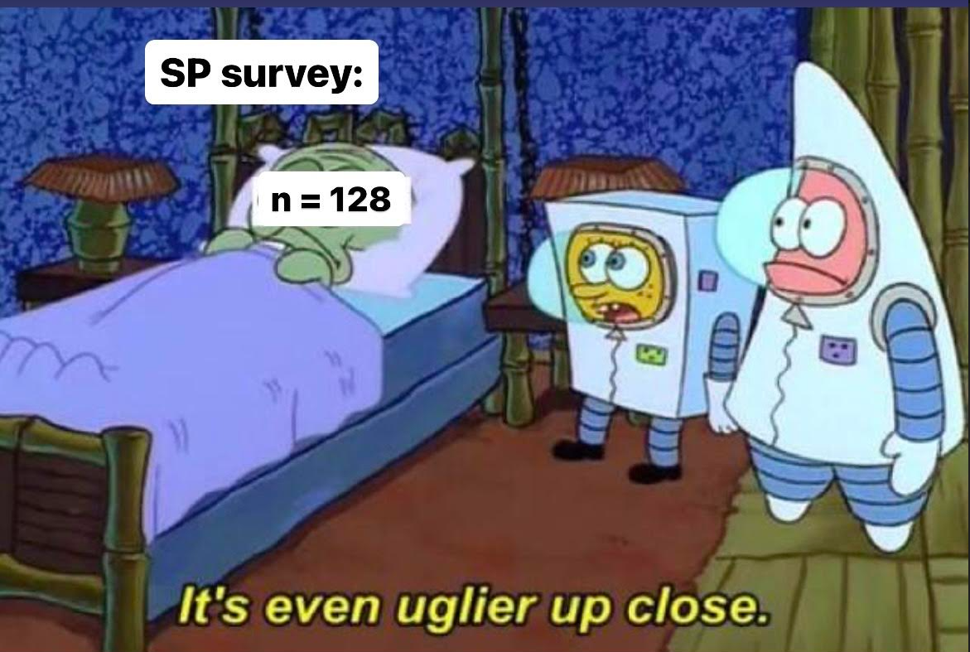
LIMITATIONS
Small sample size (n = 128)
Sample bias towards graduate planning/engineering students
Model does not capture correlation between modes
Notes:
Giuseppe

Slide 19
Conclusions & Recommendations

Slide 20
STUDY FINDINGS
BayPass increases bus ridership by 23 percent and rail ridership by 26 percent
Willingness to pay for BayPass is high ($6.55 per trip), also indicating the “value of free”
Notes:
Giuseppe

Slide 21
PILOT PROGRAM RECOMMENDATIONS
For the next phase of implementation, target employers in transit-rich areas for maximum impact and consider company WFH percentages
Use willingness-to-pay data to market BayPass to employers and universities
Consider also incorporating bikeshare and scootershare into the pilot
Notes:
Priya

Slide 22
POLICY RECOMMENDATIONS
The Metropolitan Transportation Commission should fund BayPass expansion permanently to aid in the Bay Area’s transit recovery
Use the data and results of this study (significant mode shift) as proof of concept to California AB 1919 and AB 2222
Notes:
Priya

Slide 23
FUTURE WORK
Consider refining the model further - nested/cross/latent class logit models
Take housing decisions into consideration of mode choice analysis/spatial analysis
Consider other factors in the model, eg. weather, safety, time of day, etc.
Understand how BayPass affects trip chaining behavior across different transit agencies
Notes:
Priya

Slide 24
THANK YOU!
QUESTIONS?

Slide 25
REFERENCES
Clipper BayPass launches with unlimited transit access | bart.gov. (2022, August 15). BART.gov. Retrieved March 10, 2023, from https://www.bart.gov/news/articles/2022/news20220815
Fonseca, R. (2022, September 16). Gov. Newsom vetoes bill to fund Free Transit for california students. LAist. Retrieved April 27, 2023, from https://laist.com/news/transportation/gov-newsom-vetoes-bill-to-fund-free-transit-for-california-students
Open States. (n.d.). AB 2222. California Assembly (20152016) - Open States. Retrieved April 27, 2023, from https://openstates.org/ca/bills/20152016/AB2222/
“Greenhouse Gas Emissions from a Typical Passenger Vehicle.” EPA, Environmental Protection Agency, https://www.epa.gov/greenvehicles/greenhouse-gas-emissions-typical-passenger-vehicle.
Walker, J. (2023). Session 14-16 AGGREGATE FORECASTING & MODEL APPLICATION, lecture notes, CE 264: Behavioral Modeling, University of California, Berkeley.

Slide 26
APPENDICES

Slide 27
DIVERSITY STATEMENT
Team BayPass is committed to weaving diversity, equity, and inclusion into all aspects of our project
We are cognizant that diversity encompasses many factors (race, ethnicity, gender, sexual orientation, religion, age, ability, socioeconomic status, etc.)
Our multidisciplinary team is composed of civil engineering, city planning, and computer science undergraduate and graduate students, with consideration for gender diversity and a range of educational/industry experiences
Half our team is also composed of out-of-state/international students to enable a broadened perspective on our chosen project topic.

Slide 28
AUTHOR CONTRIBUTION
Member | Tasks
Angie Chen | Championed Qualtrics & SP survey development, flyer creation, and distribution Data cleaning
Cam Kees | Assisted with development of base model Championed GIS work
Andre Soucy | Produced descriptive statistics Data cleaning
Priya Pallivathucal | Prepared weights for forecasting work Assisted in debugging base model Data cleaning Slide deck
Giuseppe Perona | Championed forecasting work Data cleaning
Melody Tsao | Championed development of base model Assisted with forecasting work Coordination with Joan/Phoebe (greatest attendance in office hours) Championed data cleaning
Winnie Zhuang | Prepared weights for forecasting work Data cleaning Coordination with Berkeley Parking & Transportation, MTC/BART Slide deck

Slide 29
DETAILED SURVEY
Question | Possible Outcomes
Do you consent to providing the data in the survey? | Yes, I consent No, I do not consent
What is your UC Berkeley campus affiliation? | Undergraduate student Graduate student Postdoc Faculty member Non-faculty university employee Retired or emeritus status Alumnus I am not affiliated with UC Berkeley
Gender: How do you identify? Select all that apply. | Male Female Non-binary Prefer not to say Prefer to self-describe (type below)
Race/Ethnicity: How do you identify? Select all that apply. | White Black or African American Native American or Indigenous Asian Middle Eastern or North African Native Hawaiian or Pacific Islander Hispanic or Latinx Prefer not to say Other (type below)

Slide 30
DETAILED SURVEY
Question | Possible Outcomes
Are you currently employed? Select all that apply. | Yes, employed off campus Yes, employed on campus as a student Yes, employed on campus as faculty/staff No
What is the zipcode of your Bay Area residence? | User input
What modes of transportation are you likely to use in a typical week? Select all that apply. | Bear Transit AC Transit BART Walk Personal bike Personal scooter, e-scooter, skateboard, or other micromobility device Shared micromobility (ex: Bay Wheels, Veo, Spin) Drive alone Carpool Rideshare (ex: Uber, Lyft) Personal mobility device (ex: wheelchair) Other (type below)
We’re going to ask you to imagine two sets of three scenarios each (six total) where you have to pick between different transportation modes for a one-way trip. Assume that every trip starts from your home. Which mode of transportation would you choose? | Walk Bike or Scooter Bus Rail (BART, Caltrain) Drive Rideshare

Slide 31
DETAILED SURVEY
Without BayPass | Walk | Bike or Scooter | Bus | Rail (BART, Caltrain) | Drive | Rideshare
Travel Time (min) | 17-55 | 12-40 | 5-35 | 5-35 | 5-25 | 5-25
Waiting or Parking Time (min) | 0 | 0 | 0-20 | 0-20 | 0-20 | 0-20
Travel Cost ($) | 0 | 0 | 1-6 | 1-8 | 1-10 | 5-20
With BayPass | Walk | Bike or Scooter | Bus | Rail (BART, Caltrain) | Drive | Rideshare
Travel Time (min) | 17-55 | 12-40 | 5-35 | 5-35 | 5-25 | 5-25
Waiting or Parking Time (min) | 0 | 0 | 0-20 | 0-20 | 0-20 | 0-20
Travel Cost ($) | 0 | 0 | 0 | 0 | 1-10 | 5-20

Slide 32
DETAILED SURVEY
Question | Possible Outcomes
BayPass is an all-inclusive multi-agency transit pass that gives you access to all public transit in the Bay Area (Muni, BART, Caltrain, ferry, etc.). Students who were randomly selected to receive the Clipper BayPass were notified via email in Fall 2022. Did you receive the Clipper BayPass? | Yes No Not sure

Slide 33
DETAILED MODEL RESULTS

Slide 34
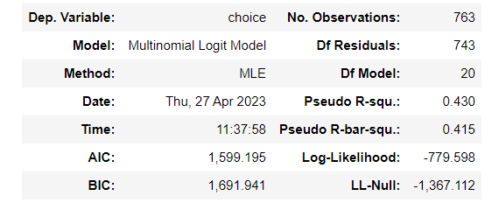
DETAILED MODEL RESULTS

